Slide 1
Towards a More Democratic Mining in Bitcoins
Goutam Paul
R. C. Bose Centre for Cryptology & Security, Indian Statistical Institute
Pratik Sarkar
Indian Institute of Engineering Science & Technology, Shibpur
Sarbajit Mukerjee
Department of Computer Science, Utah State University, U.S.A.

Slide 2
What is Bitcoin?
Bitcoin is an online payment system.
It works in a P2P network without any central organization to monitor the transactions.
The users verify the transactions among themselves.
Each user has a Bitcoin wallet which stores his Bitcoins in addresses and accounts.

Slide 3
Bitcoin Wallet
Wallet is an encrypted computer file where bitcoins are stored.
Wallet can live in almost any physical device.
The user’s identity is disguised (users employ pseudonyms).
The wallet contains user accounts with addresses.
User Accounts
Addresses
Bitcoins
Bitcoin Wallet
Addresses
Bitcoins
User Accounts
Addresses
Bitcoins

Slide 4
Bitcoin Addresses
A Bitcoin address is an 27-43 length alphanumeric string
Used for payments in Bitcoin system
Each address is the hash of a ECDSA public key.
The corresponding private key is required to spend the Bitcoins in that address.

Slide 5
Bitcoin Network
Each user node runs the following algorithm:
  New transactions are broadcast to all nodes.
  Each node collects new transactions in a block.
  Each node works on finding a proof-of-work for its block.

Slide 6
Bitcoin Network (contd.)
  When a node finds a proof-of-work, it broadcasts the block to all nodes.
  Other Nodes accept the block only if all transactions in it are valid and not already spent (check all the transactions).
  Nodes express their acceptance by working on creating the next block in the chain, using the hash of the accepted block as the previous hash.

Slide 7
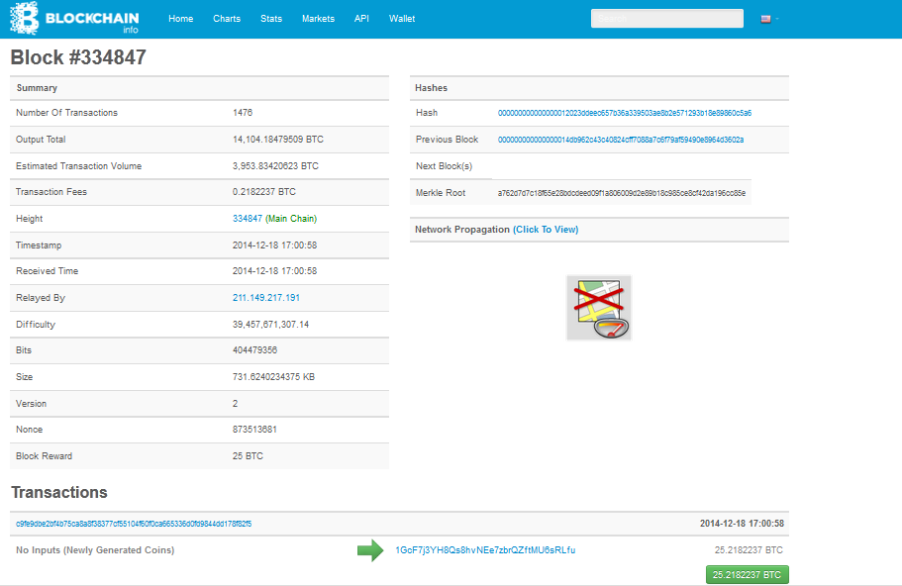
A Bitcoin Block

Slide 8
Bitcoin Mining
To verify the transactions, Bitcoin system relies on a network of miners who collectively work towards implementing a replicated ledger for keeping track of all the accounts in the system.
All the Bitcoin miners independently try to find the winning block by finding a hash lower than a particular target specified by the Bitcoin system.
The Bitcoin miners use proof-of-work protocol to find new blocks

Slide 9
Proof-of-Work Protocol
Proof-of-Work is a protocol used to artificially impose transaction costs.
The main goal is to “charge” the requester of a service with the efforts to provide a solution to a puzzle, which would be much harder to do than to be verified.
    A Block contains transactions to be validated and previous hash value.

Slide 10
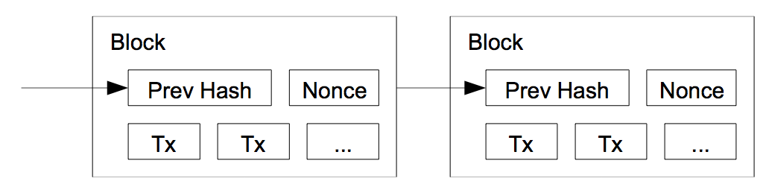
Proof-of-Work Protocol (contd.)
Pick a nonce such that Hash(prev hash, nonce, T_{x}) < E, where E is the difficulty of system
    Work required is exponential in the number of zero bits required.
Upon successful generation of a block, a miner is granted a fixed amount of BTCs, known as coin-based transaction, plus the transaction fees from all the transactions that have been included in the block.
Proof of Work Protocol

Slide 11
Problem being Addressed
Increasing hash rate of Bitcoin system
51% attack possibility
Block race and Selfish Mining
Remove variable coin generation

Slide 12
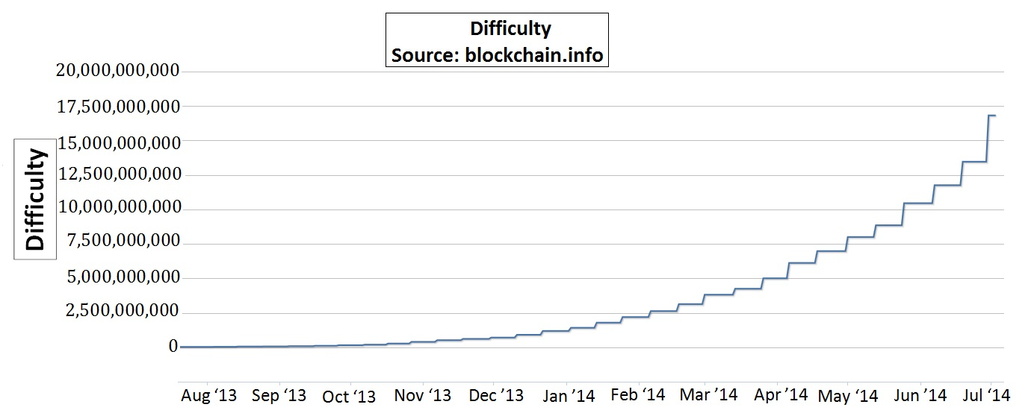
Increasing Hash Rate
Increasing difficulty of the Bitcoin system
Increasing hashing power for PoW protocol
Increases the requirement for higher computing power
We try to reduce the computing power requirement

Slide 13
51% Attack
Suppose a single entity/group/pool contributes to the majority of the network’s mining hashrate.
Then they would have full control of the network and can change the current blocks and the future blocks of the blockchain at will.
They will be generating majority of the blocks and including the transactions in them.

Slide 14
51% Attack (contd...)
They could prevent transactions from gaining any confirmations
Prevent people from sending Bitcoins between
  addresses
Reverse transactions that happen when they
  generate the blocks (also allowing double spend transactions)
Prevent other miners from finding any blocks for a
  short period of time.

Slide 15
51% Attack (contd...)
Cannot generate new coins without following the proof-of-work protocol
Cannot steal coins from Bitcoins addresses
Cannot affect any past blocks or change any transaction recorded in them.

Slide 16
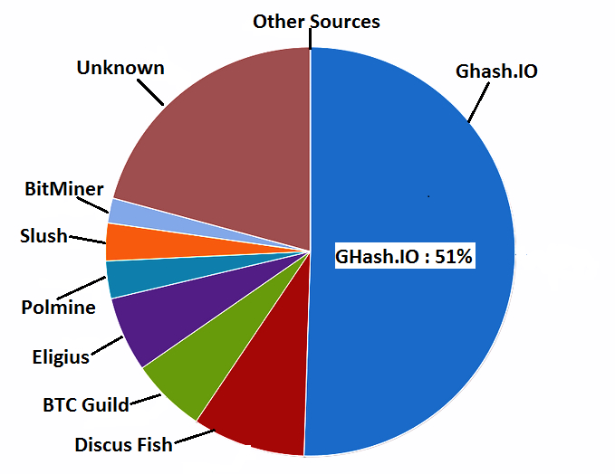
Defense against 51% Attack
On 14th June 2014, a particular mining pool was able to take control of 51% of Bitcoins processing power, thus extracting the maximum amount of profit for their work.
Mining pools generates majority of the blocks
  More than 75% of mining is controlled by pools
  Ghash.IO secured 51% of the mining rights, creating a 51% attack possibility
In this paper, we introduce a new defense against this 51% attack.

Slide 17
Prevent Selfish Mining
Block Races and Selfish Mining [1] : The mining pools can pursue selfish mining to prevent the blocks of other users from being added into the blockchain. This can lead to 51% attack.
We ensure a fair mining process and thus remove the chances of Block races and selfish mining.
[1] Eyal, Ittay and Sirer, Emin Gῢn Sirer, “Majority is not enough: Bitcoin mining is
Vulnerable”, Financial Cryptography 2014: 436-454

Slide 18
Guarantee Fixed Generation Rate
The Bitcoins are generated at an average of 10 minutes but it varies a lot.
Variable time can lead to problems like transaction malleability [2] which has lead to frauds.
This scheme guarantees a 10 minutes generation rate.
[2] https://en.bitcoin.it/wiki/Transaction_Malleability

Slide 19
Our Proposal
Modify the target achieving proof-of-work protocol by minimum hash generation by miner nodes across the Bitcoin network.
The user with the minimum hash after 10 minutes gets the mining rights.
The process is divided into 3 phases:
  Hash Generation
  Hash Broadcast
  Hash Verification

Slide 20
Changes Introduced
The present bitcoin header has been modified
The target field has been replaced by the Bitcoin address of the miner
Users do not have to meet a target
Bitcoin address of miner is required to identify the miner during hash verification

Slide 21
Block Header Formats
Name | Byte Size | Description
Version (V) | 4 | Block Version Number.
Previous Hash (P_{h}) | 32 | This is the hash of the previous block header.
Merkle Root (H_{t}) | 32 | The hash based on all the transactions present in the current block.
Time (T) | 4 | Current Timestamp in seconds (unix format).
Target | 4 | Target value in compact form.
Nonce (R) | 4 | User adjusted value starting from 0.
Name | Byte Size | Description
Version (V) | 4 | Block Version Number.
Previous Hash (P_{h}) | 32 | This is the hash of the previous block header.
Merkle Root (H_{t}) | 32 | The hash based on all the transactions present in the current block.
Time (T) | 4 | Current Timestamp in seconds (unix format).
Bitcoin Address (U_{p}) | 20 | Hash of the Public key of the receiving address.
Nonce (R) | 4 | User adjusted value starting from 0.
Present Block Header Format
Proposed Block Header Format

Slide 22
Hash Generation Phase (cont.)
It continues for 2 minutes
Generate SHA-256 hashes H of the proposed Block Header fields by changing the Nonce value at different timestamps (T)
H = SHA(SHA(V ||Hp||T ||Up||H_{t}||R||P)) ; P = Padding
Select the minimum Hash H_{min} among generated hashes
Form Hash Message: Block Header and Hash H_{min}
Each node contains two fields: STATE (denotes states of node)and M_{min} (Contains minimum hash message)

Slide 23
Hash Generation Phase (cont.)
Call Initialize() with H_{min} for each node N_{i}
Update the M_{min} to the message containing H_{min}
Update STATE to ACTIVE
Start Hash Broadcasting phase

Slide 24
Hash Generation Phase (cont.)
Procedure Initialize (Hash Message M);
for all Nodes in the network do
N_{i}.M_{min} = M, where M_{min} is the minimum hash message at each node;
N_{i}.STATE = ACTIVE;
end for

Slide 25
Hash Broadcasting Phase
Each leaf node starts this phase by broadcasting it M_{min} to its parent and becomes PROCESSING (calls LeafSending() )
Each internal node receives the message:
  calls the Receiving_Active(M) function on receiving a message M from its neighbors.
  Processes the message by calling Process Message(M)
  If it has received from all neighbors except 1, then he forwards the M_{min} with him to that one neighbor which becomes its parent and becomes PROCESSING

Slide 26
Hash Broadcasting Algorithm (Active Phase)
Procedure LeafSending()
for all Active Leaf Nodes in the network do
parent ⇐ Neighbors;
send N_{i}.M_{min} to parent;
N_{i}.STATE = PROCESSING;
end for

Slide 27
Hash Broadcasting Algorithm (Active Phase) (cont.)
Procedure Receiving_Active(M)
for all Active Internal Nodes in the network do
N_{i}.M_{min} = Process Message(M);
Neighbors:= Neighbors - sender;
if number of Neighbors = 1 then
parent ⇐ Neighbors;
send N_{i}.M_{min} to parent;
N_{i}.STATE = PROCESSING;
end if
end for

Slide 28
Hash Broadcasting Algorithm (Active Phase)
(cont.)
Procedure Process_Message(M)
for all Nodes in the network do
if N_{i}.M_{min}.H <M.H then
return N_{i}.M_{min};
else
return M ;
end if
end for

Slide 29
Hash Broadcasting Phase(Processing Phase)
(cont.)
When a node in PROCESSING state receives a message it becomes SATURATED by calling Receiving_Processing() and starts the hash verification stage by making M_{min} public
The algorithm [3] states that exactly two nodes will be SATURATED and they will be neighbors. These two nodes will contain the same M_{min} with them.
[3] Santoro, Nikola. Design and Analysis of Distributed Algorithms (Wiley Series on Parallel and Distributed Computing). Wiley-Interscience, 2006. pages 71-76.

Slide 30
Hash Broadcasting Algorithm (Processing Phase) (cont.)
Procedure Receiving_Processing(M)
for all Processing Nodes in the network do
N_{i}.STATE = SATURATED;
N_{i}.M_{min} = Process_Message(M);
Announce M;
Start Verification stage;
end for

Slide 31
Hash Verification Phase
Finds the true minimum hash of the system
The hash message chosen by the two saturated nodes is verified by the peers
Any node having lower hash message can claim his hash as:
  His message is verified
  The broadcasted hash message is discarded
  The owner of the message generates the next block
The hash broadcast and verification stage continues for 8 mins

Slide 32
Security Features
High computing power does not give additional advantage :
  Each node is independent
  Does not know about the hash of other nodes
The hashes are verified by the peer nodes and a hash will be discarded only if:
  The hash value does not match with the hash of the header fields
  It is bigger than some other hash, which has been verified
Evil nodes cannot affect the verification stage because they can discard a hash only if any of the above conditions hold

Slide 33
Message Complexity
Total number of active nodes = n
We used the saturation stage of [3]
The message complexity for this scheme is O(n).
[3] Santoro, Nikola. Design and Analysis of Distributed Algorithms (Wiley Series on
Parallel and Distributed Computing). Wiley-Interscience, 2006. pages 71-76.

Slide 34
Greener Bitcoins
In the original Bitcoin scheme
  Hash generation occurs all the time.
  Mining process totally depends on computation power intensive work.
In our scheme
  Hash generation occurs only for 2 mins for every 10 mins.
  It uses up 1/5th of the power.
  Mining process depends on luck, and not computing power intensive
  Greener Approach to mining.

Slide 35
Advantages
Generates Bitcoins at a fixed rate of 10 minutes which can be adjusted
Decentralizes the Bitcoin mining process from the hands of mining pools and introduces a luck factor in mining.
Reduces Power consumption by 1/5th times the PoW protocol as only 2 minutes out of 10 minutes is used for hash generation

Slide 36
Conclusion
Analyzed the major weaknesses of the existing PoW protocol and proposed an alternative solution
Large computing power doesn't guarantee block generation
Generates the coins at a fixed rate
Mining is more environment friendly and democratic

Slide 37
Thank you

